Slide 1
Project : Disney+HotStar Data Analysis
Name: Giridaran R A
Batch code: MBE9

Slide 2
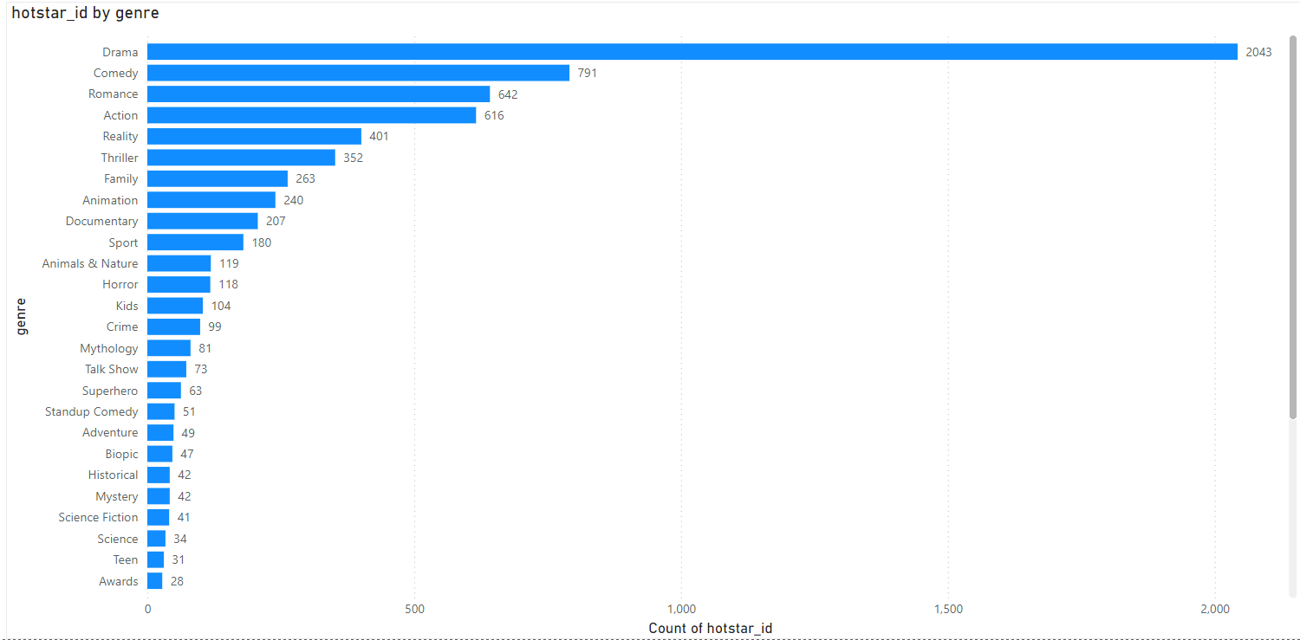
Distribution of Movies by Genre
Identifying the most and least popular genres can help content platforms focus on genres with higher engagement.
Understanding genre diversity helps in ensuring a balanced content library.

Slide 3
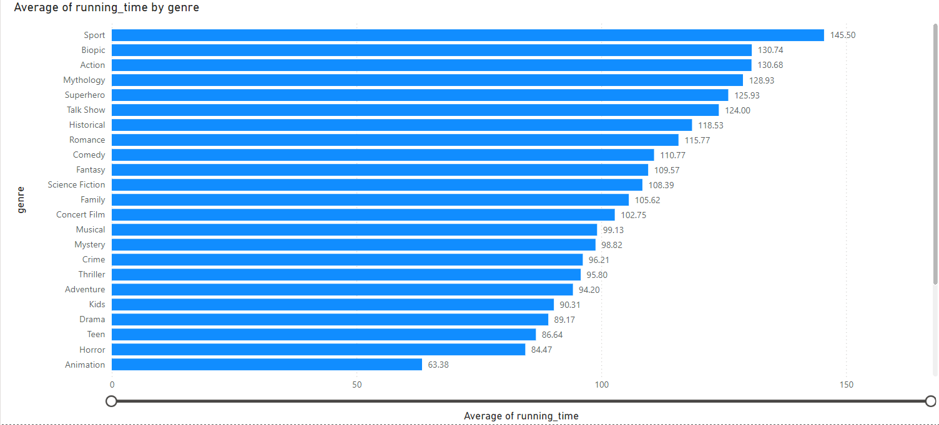
Average Running Time by Genre
Genres with longer average running times could indicate more in-depth storytelling (e.g., Drama or Epic genres) while shorter genres might be more casual (e.g., Comedy).

Slide 4
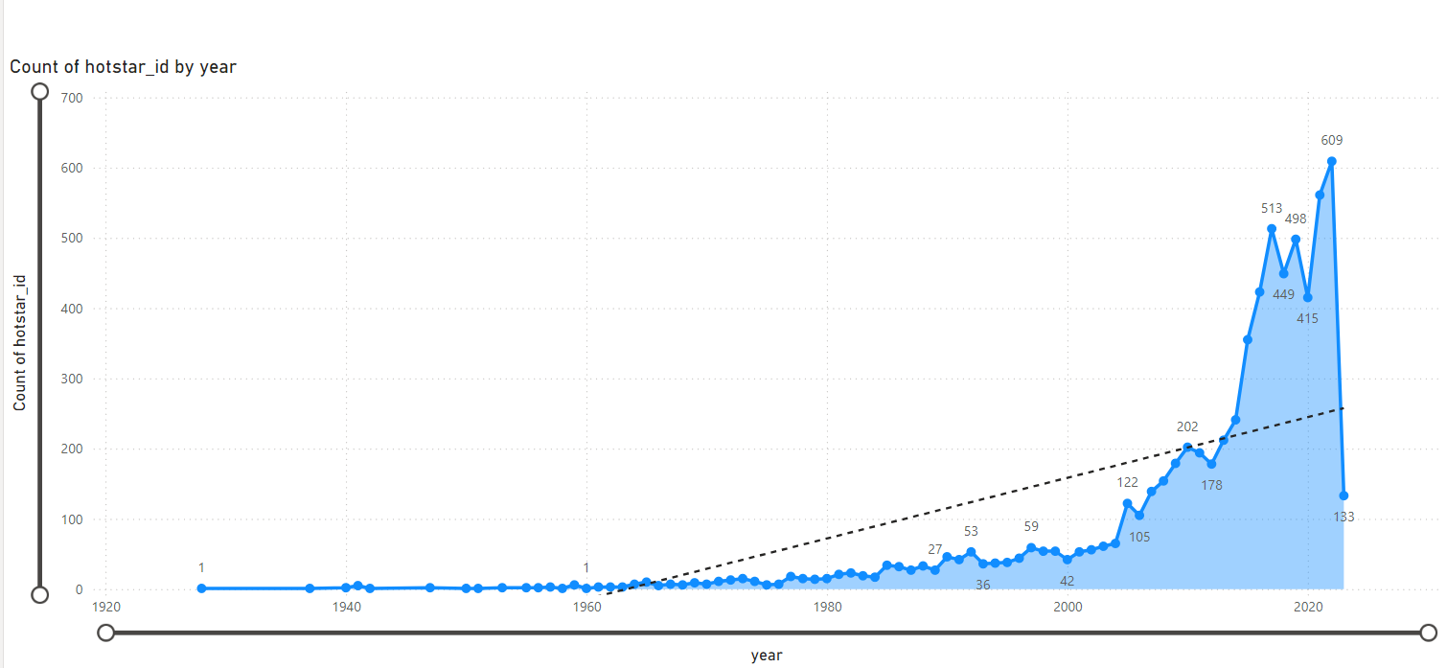
Movies Released Each Year
Trends in movie production can reveal industry growth or contraction and seasonal patterns.

Slide 5
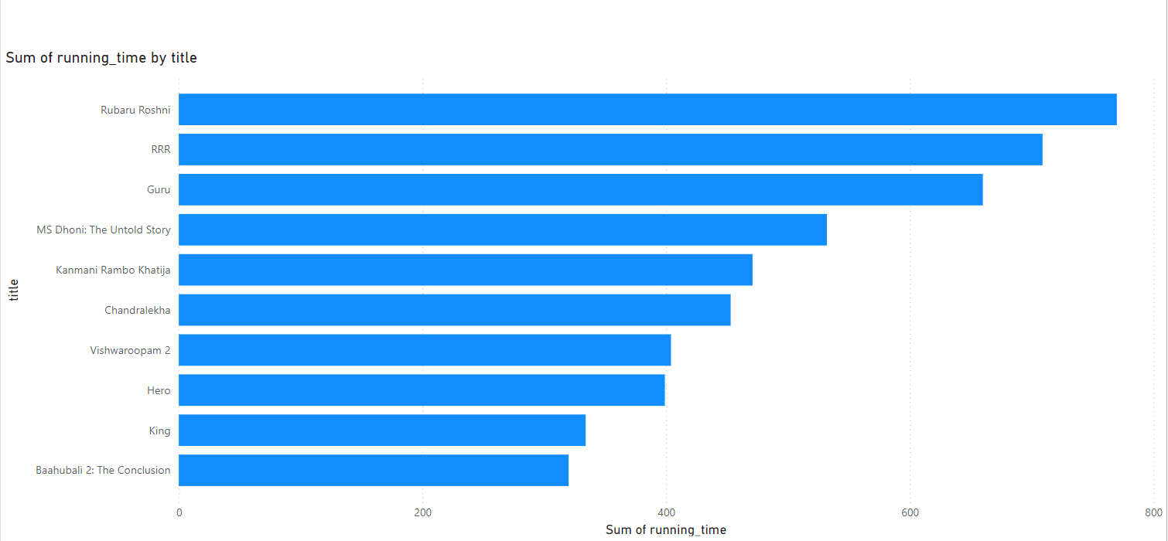
Top 10 Longest Movies
Highlighting these can indicate trends in movie length preferences and the production of epic or serialized content.

Slide 6
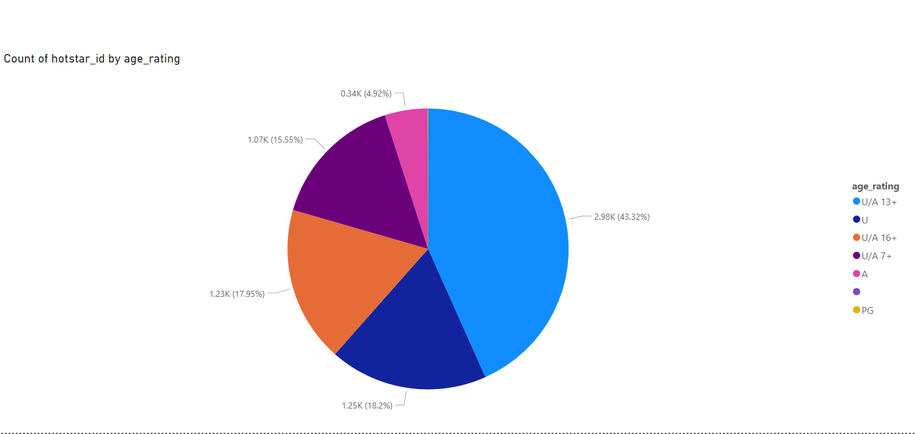
Movies by Age Rating
Analyzing age ratings helps in understanding the target audience and ensuring content meets audience expectations.

Slide 7
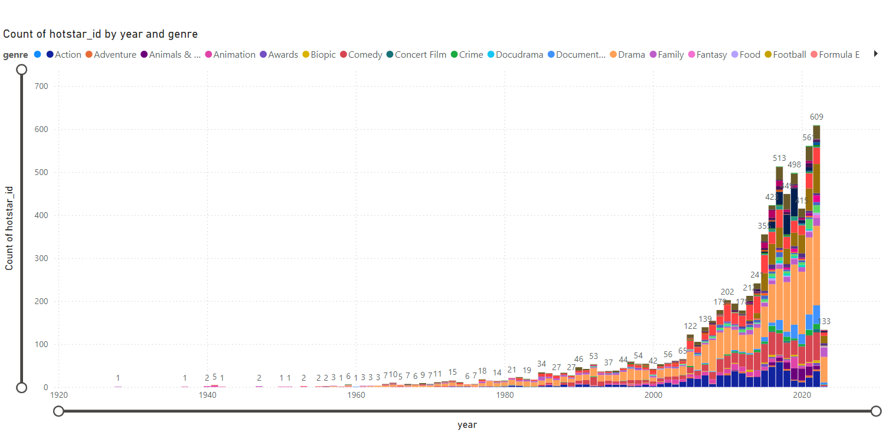
Count of Movies by Year and Genre
Provides insights into how genre popularity evolves over time, which can influence future content strategies.

Slide 8
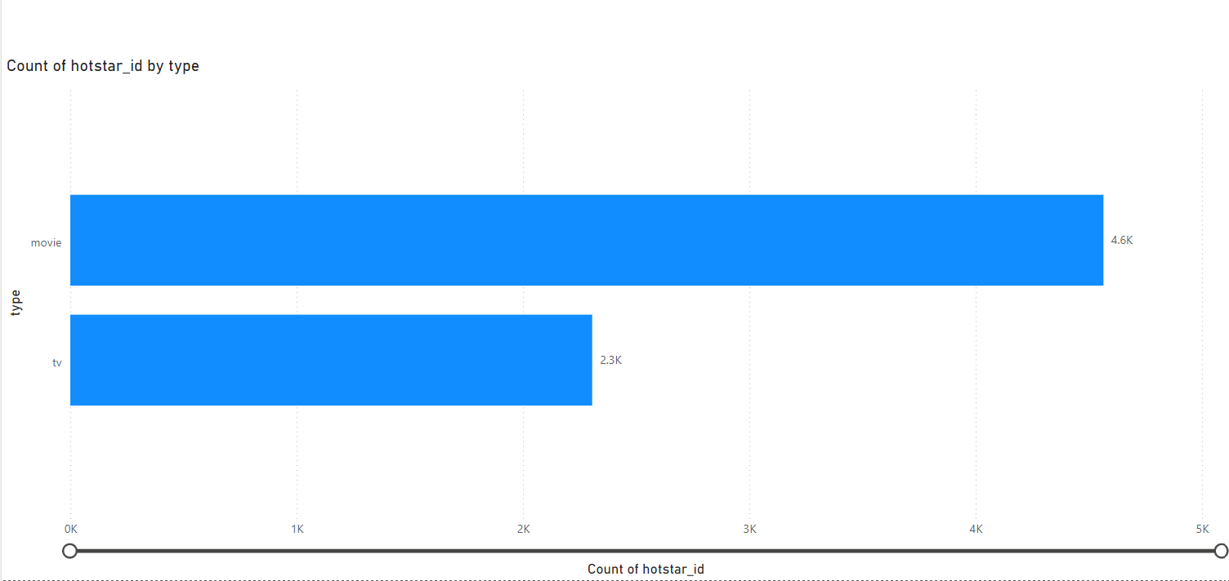
Most Common Movie Types
Differentiating between movie types (e.g., documentary vs. feature film) helps in understanding the platform's content mix.

Slide 9
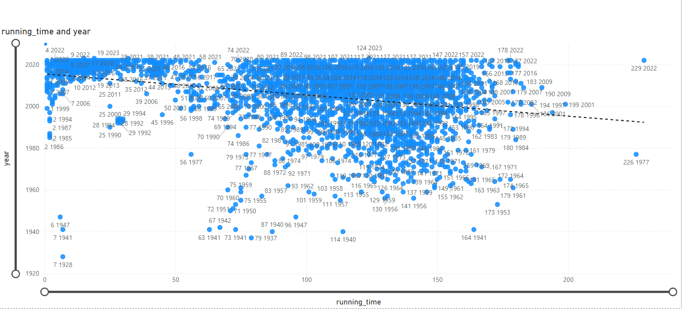
Correlation Between Running Time and Year
Shows if there’s a trend towards longer or shorter movies over time, which can impact viewer preferences and production decisions.

Slide 10
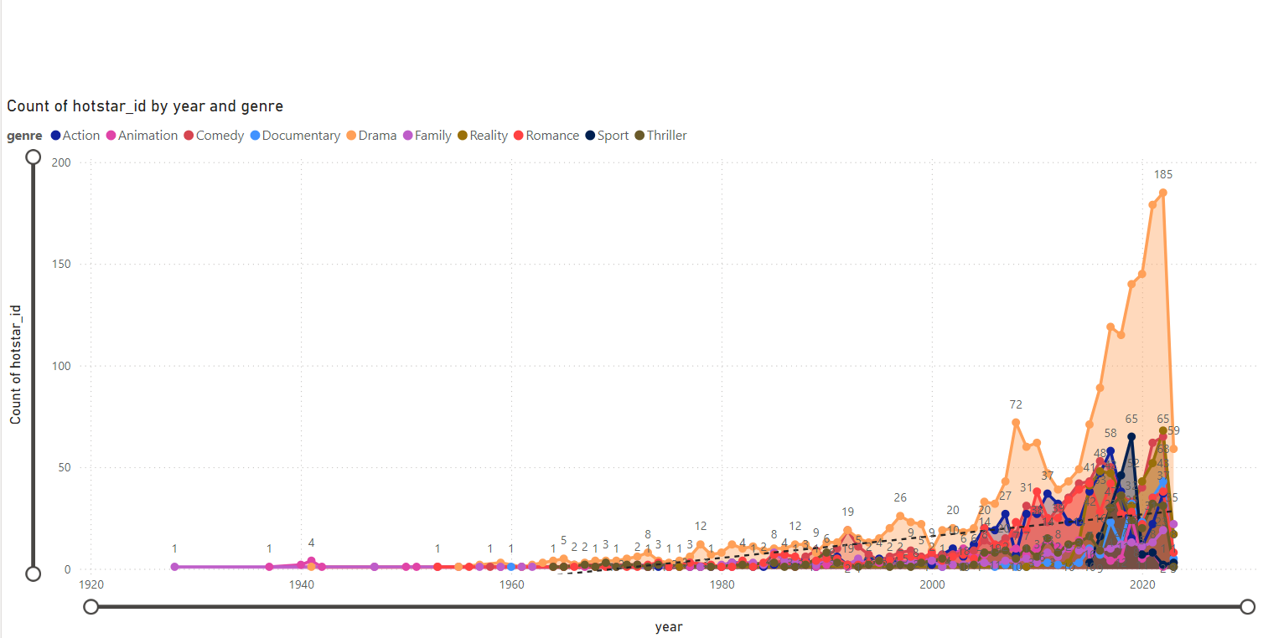
Genre Popularity Over Time
Helps in predicting future trends and adjusting content strategy to align with emerging preferences.

Slide 11
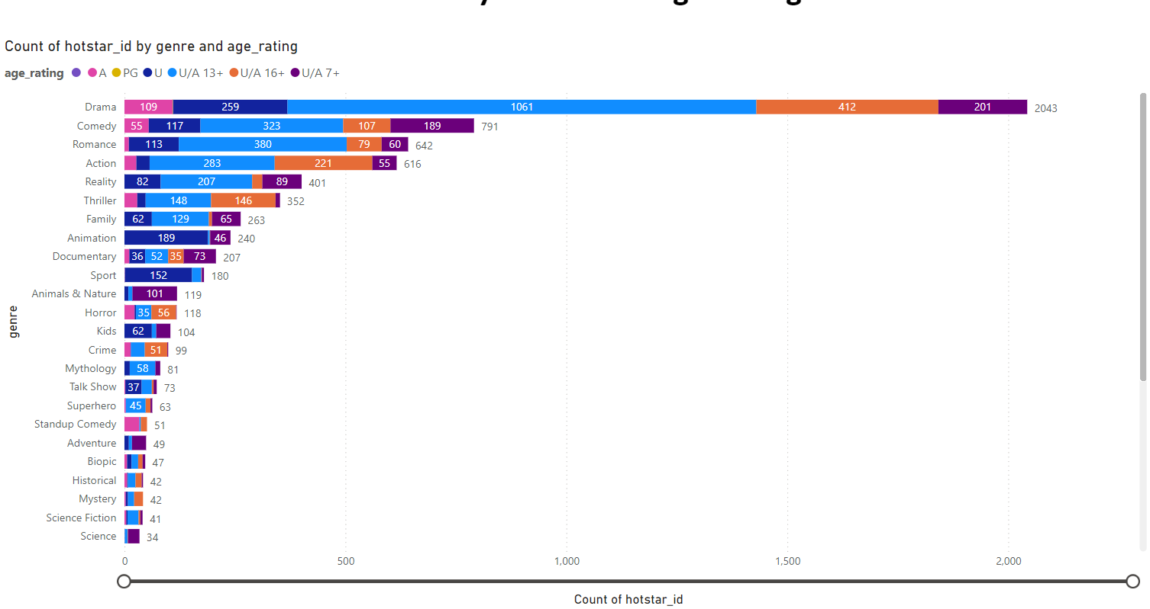
Movies by Genre and Age Rating
Highlights the overlap between genres and age ratings, which can assist in targeted marketing and content recommendations.

Slide 12
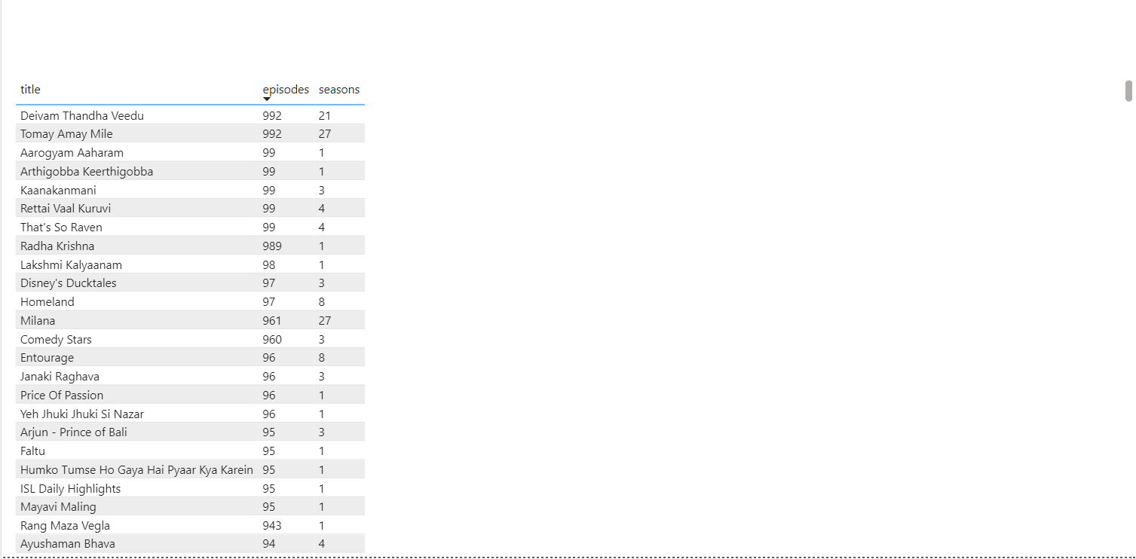
Movies with Maximum Episodes
Shows popular long-running series, which can guide future content creation and acquisition.

Slide 13
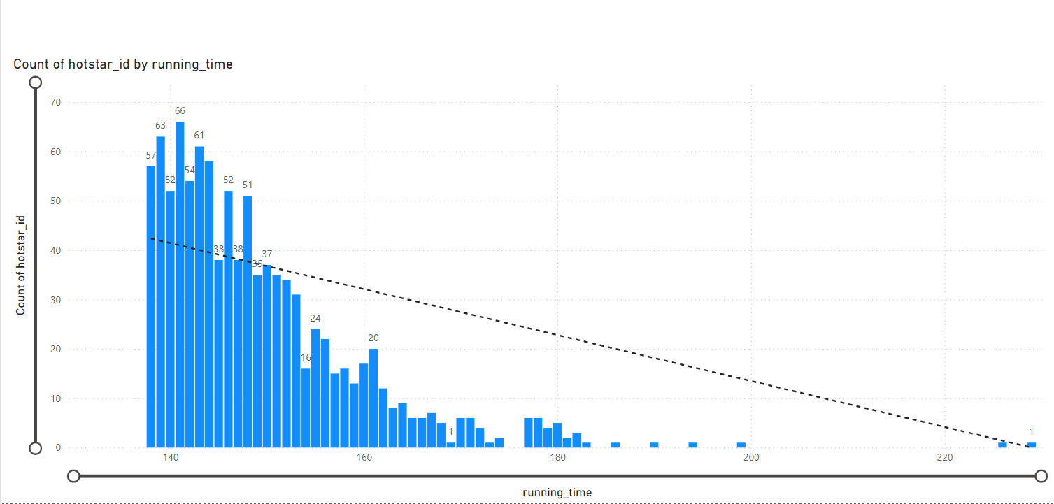
Distribution of Running Time
Reveals the typical length of movies available, which can help in understanding audience tolerance for movie length.

Slide 14
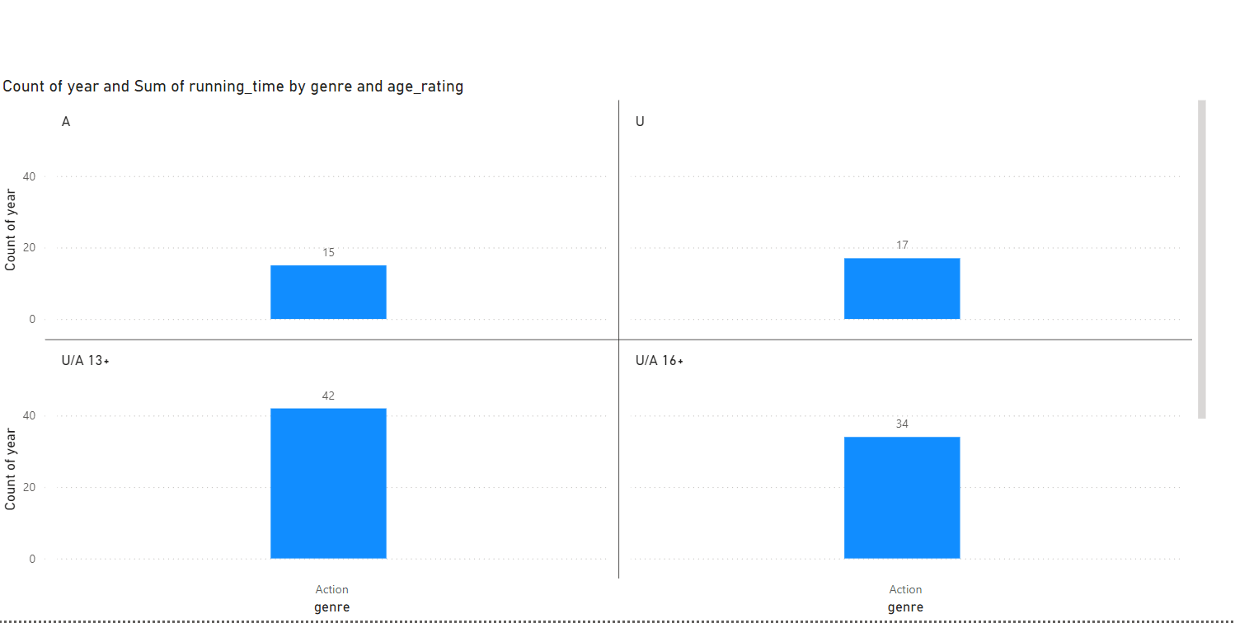
Analysis of Specific Genres
Provides detailed insights into individual genres, revealing unique patterns and preferences.

Slide 15
Project Summary: Disney+Hotstar Data Analysis
Goal: To provide an in-depth analysis of the Disney+Hotstar movie dataset to uncover insights and trends that can be leveraged for business decisions.
Key Findings:
Genre Popularity: Action, Drama, and Comedy are the most popular genres.
Running Time Trends: Movies have generally become longer over time, with an average running time of around 120 minutes.
Age Rating Distribution: Most movies are rated U/A, followed by PG and A.
Content Trends: There has been a steady increase in the number of movies released each year.
Specific Genre Analysis (e.g., Action): Action movies tend to have longer running times and are often rated U/A.

Slide 16
Recommendations:
Content Strategy: Focus on producing more content in the popular genres of Action, Drama, and Comedy. Consider exploring niche genres to cater to specific audiences.
Audience Segmentation: Tailor recommendations based on age ratings and running times to target specific audience segments.
Marketing Campaigns: Utilize insights into popular genres and release trends to create targeted marketing campaigns.
Historical Analysis: Analyze historical trends to identify emerging genres and potential market shifts.
User Behavior: Analyze user data (if available) to understand viewing habits, preferences, and engagement levels.
Competition: Analyze competitor data to identify market trends and opportunities.
Technological Advancements: Stay updated on emerging technologies (e.g., VR, AR) and explore potential applications.

Slide 17
Thank you

